Slide 1


http://www.comp.nus.edu.sg/~cs2100/
Lecture #2a
Overview of C Programming

Slide 2
Questions?
IMPORTANT: DO NOT SCAN THE QR CODE IN THE VIDEO RECORDINGS. THEY NO LONGER WORK
Ask at
https://sets.netlify.app/module/676ca3a07d7f5ffc1741dc65
OR
Scan and ask your questions here! (May be obscured in some slides)

Slide 3
Lecture #2: Overview of C Programming (1/2)
A Simple C Program
von Neumann Architecture
Variables
Data Types
Program Structure
5.1 Preprocessor Directives
5.2 Input/Output
5.3 Compute
Arithmetic operators
Assignment statements
Typecast operator

Slide 4
Lecture #2: Overview of C Programming (2/2)
Selection Statements
6.1 Condition and Relational Operators
6.2 Truth Values
6.3 Logical Operators
6.4 Evaluation of Boolean Expressions
6.5 Short-Circuit Evaluation
Repetition Statements
7.1 Using ‘break’ in a loop
7.2 Using ‘continue’ in a loop

Slide 5
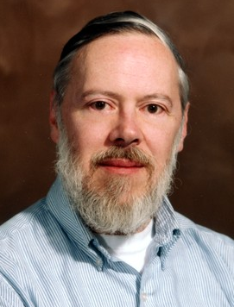
Introduction
C: A general-purpose computer programming language developed in 1972 by Dennis Ritchie (1941 – 2011) at Bell Telephone Lab for use with the UNIX operation System

Slide 6
Quick Review: Edit, Compile, Execute
Compile
Execute
Edit
Source code
Edit
produces
first.c
eg: vim first.c
Executable code
Compile
produces
a.out
Cannot compile?
eg: gcc first.c
Program output
Incorrect result?
Execute
produces
eg: a.out
The value of c is 3.

Slide 7
1. A Simple C Program (1/3)
General form
preprocessor directives
main function header
{
declaration of variables
executable statements
}
“Executable statements” usually consists of 3 parts:
Input data
Computation
Output results

Slide 8
1. A Simple C Program (2/3)
MileToKm.py
MileToKm.c
KMS_PER_MILE = 1.609 # conversion constant
def main():
# Get the distance in miles
miles = float(input("Enter distance in miles: "))
# Convert the distance to km
kms = KMS_PER_MILE * miles
# Display the distance in km
print("That equals", kms, km.");
return 0
if name == "__main__":
main()
// Converts distance in miles to kilometres.
#include <stdio.h> /* printf, scanf definitions */
#define KMS_PER_MILE 1.609 /* conversion constant */
int main(void) {
float miles, // input – distance in miles
kms; // output – distance in kilometres
/* Get the distance in miles */
printf("Enter distance in miles: ");
scanf("%f", &miles);
// Convert the distance to kilometres
kms = KMS_PER_MILE * miles;
// Display the distance in kilometres
printf("That equals %9.2f km.\n", kms);
return 0;
}
Sample run
$ gcc MileToKm.c
$ a.out
Enter distance in miles:
10.5
That equals 16.89 km.
(Note: All C programs in the lectures are available on LumiNUS as well as the CS2100 website. Python versions are also available.)

Slide 9
1. A Simple C Program (3/3)
// Converts distance in miles to kilometres.
#include <stdio.h> /* printf, scanf definitions */
#define KMS_PER_MILE 1.609 /* conversion constant */
int main(void) {
float miles, // input – distance in miles
kms; // output – distance in kilometres
/* Get the distance in miles */
printf("Enter distance in miles: ");
scanf("%f", &miles);
// Convert the distance to kilometres
kms = KMS_PER_MILE * miles;
// Display the distance in kilometres
printf("That equals %9.2f km.\n", kms);
return 0;
}
standard header file
preprocessor directives
constant
reserved words
variables
comments
(Only /* … */ is ANSI C)
functions
special symbols
In C, semi-colon (;) terminates a statement.
Curly bracket { } indicates a block.
In Python: block is by indentation

Slide 10
2. von Neumann Architecture (1/2)
What happens in the computer memory?
memory
memory
memory
Executable code of MileToKm.c
Executable code of MileToKm.c
Executable code of MileToKm.c
miles
miles
miles
?
10.5
10.5
kms
kms
kms
?
?
16.89
At the beginning
After user enters: 10.5 to
scanf("%f", &miles);
After this line is executed:
kms = KMS_PER_MILE * miles;
Do not assume that uninitialised variables contain zero! (Very common mistake.)

Slide 11
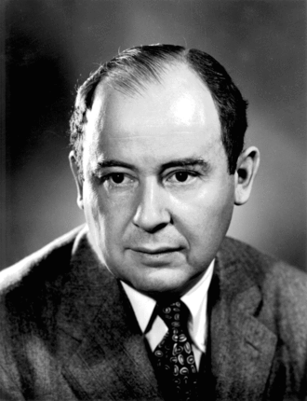
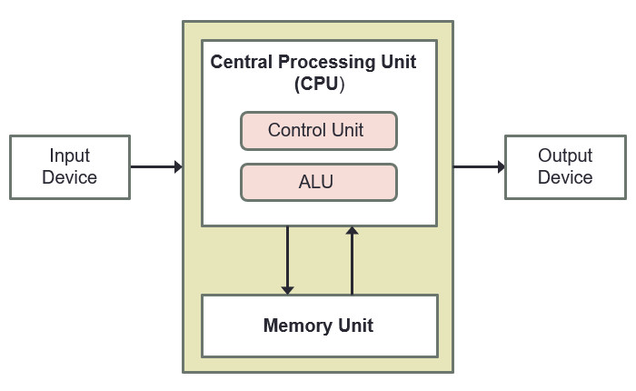
2. von Neumann Architecture (2/2)
John von Neumann (1903 – 1957)
von Neumann architecture* describes a computer consisting of:
Central Processing Unit (CPU)
Registers
A control unit containing an instruction register and program counter
An arithmetic/logic unit (ALU)
Memory
Stores both program and data in random-access memory (RAM)
I/O devices
(* Also called Princeton architecture, or stored-program architecture)

Slide 12
3. Variables
float miles, kms ;
Data used in a program are stored in variables
Every variable is identified by a name (identifier), has a data type, and contains a value which could be modified
(Each variable actually has an address too, but for the moment we will skip this until we discuss pointers.)
A variable is declared with a data type
int count; // variable ‘count’ of type ‘int’
Variables may be initialized during declaration:
int count = 3; // ‘count’ is initialized to 3
Without initialization, the variable contains an unknown value (Cannot assume that it is zero!)
Python
Declaration via assignment in function/global
count = 3

Slide 13
3. Variables: Mistakes in Initialization
InitVariable.c
No initialization
int main(void) {
int count;
count = count + 12;
return 0;
}
Python
-Wall option turns on all warnings
Cannot declare without initialization
$ gcc –Wall InitVariable.c
InitVariable.c: In function 'main':
InitVariable.c:3:8: warning: 'count' is used uninitialized in this function
count = count + 12;
^
Redundant initialization
int count = 0;
count = 123;
int count = 0;
scanf("%d", &count);

Slide 14
4. Data Types (1/3)
float miles, kms;
Every variable must be declared with a data type
To determine the type of data the variable may hold
Basic data types in C:
int: For integers
4 bytes (in sunfire); -2,147,483,648 (-2³¹) through +2,147,483,647 (2³¹ – 1)
float or double: For real numbers
4 bytes for float and 8 bytes for double (in sunfire)
Eg: 12.34, 0.0056, 213.0
May use scientific notation; eg: 1.5e-2 and 15.0E-3 both refer to 0.015; 12e+4 and 1.2E+5 both refer to 120000.0
char: For characters
Enclosed in a pair of single quotes
Eg: 'A', 'z', '2', '*', ' ', '\n’
Python
JS
int
number
Python
JS
float
number
Python
JS
str
string

Slide 15
4. Data Types (2/3)
A programming language can be strongly typed or weakly typed
Strongly typed: every variable to be declared with a data type. (C: int count; char grade; )
Weakly typed: the type depends on how the variable is used (JavaScript: var count; var grade;)
The above is just a simple explanation.
Much subtleties and many views and even different definitions. Other aspects include static/dynamic type checking, safe type checking, type conversions, etc.
Eg: Java, Pascal and C are strongly typed languages. But Java /Pascal are more strongly typed than C, as C supports implicit type conversions and allows pointer values to be explicitly cast.
One fun video: https://www.youtube.com/watch?v=bQdzwJWYZRU

Slide 16
4. Data Types (3/3)
DataTypes.c
// This program checks the memory size
// of each of the basic data types
#include <stdio.h>
int main(void) {
printf("Size of 'int' (in bytes): %d\n", sizeof(int));
printf("Size of 'float' (in bytes): %d\n", sizeof(float));
printf("Size of 'double' (in bytes): %d\n", sizeof(double));
printf("Size of 'char' (in bytes): %d\n", sizeof(char));
return 0;
}
Python
Use sys.getsizeof
import sys
sys.getsizeof(1)
$ gcc DataTypes.c –o DataTypes
$ DataTypes
Size of 'int' (in bytes): 4
Size of 'float' (in bytes): 4
Size of 'double' (in bytes): 8
Size of 'char' (in bytes): 1
-o option specifies name of executable file (default is ‘a.out’)

Slide 17
Programming Samples
All sample programs are available at the Lecture Slides section here:
https://www.comp.nus.edu.sg/~cs2100/2_resources/lectures.html

Slide 18
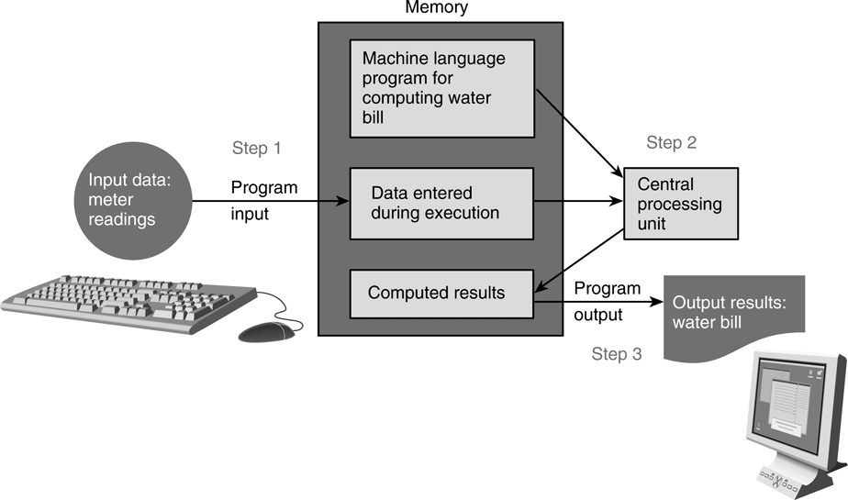
5. Program Structure
A basic C program has 4 main parts:
Preprocessor directives:
eg: #include <stdio.h>, #include <math.h>, #define PI 3.142
Input: through stdin (using scanf), or file input
Compute: through arithmetic operations and assignment statements
Output: through stdout (using printf), or file output

Slide 19
Preprocessor
Input
Compute
Output
5.1 Preprocessor Directives (1/2)
The C preprocessor provides the following
Inclusion of header files
Macro expansions
Conditional compilation
We will focus on inclusion of header files and simple application of macro expansions (defining constants)
Inclusion of header files
To use input/output functions such as scanf() and printf(), you need to include <stdio.h>: #include <stdio.h>
To use functions from certain libraries, you need to include the respective header file, examples:
To use mathematical functions, #include <math.h> (In sunfire, need to compile with –lm option)
To use string functions, #include <string.h>

Slide 20
Preprocessor
Input
Compute
Output
5.1 Preprocessor Directives (2/2)
Macro expansions
One of the uses is to define a macro for a constant value
Eg: #define PI 3.142 // use all CAP for macro
#define PI 3.142
int main(void) {
...
areaCircle = PI * radius * radius;
volCone = PI * radius * radius * height / 3.0;
}
Preprocessor replaces all instances of PI with 3.142 before passing the program to the compiler.
In Python, there is no parallel, but closest is simply declare global variable
PI = 3.142
areaCircle = PI * radius * radius
volCone = PI * radius * height / 3.0
What the compiler sees:
int main(void) {
...
areaCircle = 3.142 * radius * radius;
volCone = 3.142 * radius * radius * height / 3.0;
}

Slide 21
Preprocessor
Input
Compute
Output
5.2 Input/Output (1/3)
Input/output statements:
age
Address of variable ‘age’ varies each time a program is run.
scanf ( format string, input list );
input ( prompt = None )
printf ( format string );
20
print ( value list )
printf ( format string, print list );
One version:
“age” refers to value in the variable age.
“&age” refers to (address of) the memory cell where the value of age is stored.
age = int(input("What is your age?"))
cap = float(input("What is your CAP?"))
print("You are", age, "years old, and your CAP is", cap);
int age;
double cap; // cumulative average point
printf("What is your age? ");
scanf("%d", &age);
printf("What is your CAP? ");
scanf("%lf", &cap);
printf("You are %d years old, and your CAP is %f\n", age, cap);
InputOutput.py
InputOutput.c
Another version:
int age;
double cap; // cumulative average point
printf("What are your age and CAP? ");
scanf("%d %lf", &age, &cap);
printf("You are %d years old, and your CAP is %f\n", age, cap);
user_input = input("What are your age and CAP?")
age, cap = user_input.split(" ")
age, cap = int(age), float(cap)
print("You are", age, "years old, and your CAP is", cap);
InputOutputV2.c
InputOutputV2.py

Slide 22
Preprocessor
Input
Compute
Output
5.2 Input/Output (2/3)
%d and %lf are examples of format specifiers; they are placeholders for values to be displayed or read
Placeholder | Variable Type | Function Use
%c | char | printf / scanf
%d | int | printf / scanf
%f | float or double | printf
%f | float | scanf
%lf | double | scanf
%e | float or double | printf (for scientific notation)
Python
All inputs are read as string
Examples of format specifiers used in printf():
%5d: to display an integer in a width of 5, right justified
%8.3f: to display a real number (float or double) in a width of 8, with 3 decimal places, right justified
Note: For scanf(), just use the format specifier without indicating width, decimal places, etc.

Slide 23
Preprocessor
Input
Compute
Output
5.2 Input/Output (3/3)
\n is an example of escape sequence
Escape sequences are used in printf() function for certain special effects or to display certain characters properly
These are the more commonly used escape sequences:
Escape sequence | Meaning | Result
\n | New line | Subsequent output will appear on the next line
\t | Horizontal tab | Move to the next tab position on the current line
\" | Double quote | Display a double quote "
%% | Percent | Display a percent character %
Try out TestIO.c and compare with TestIO.py

Slide 24
End of File

